Slide 1

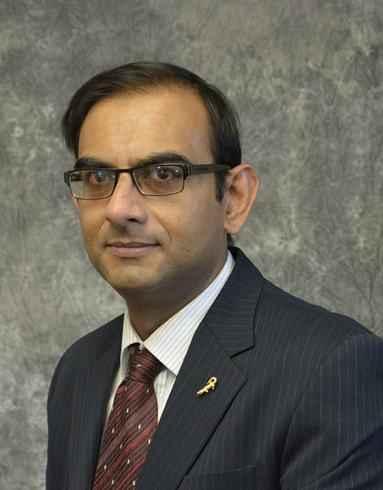
Introduction to Cloud Computing with R in Google Cloud and Amazon Web Services Software requirements
Sounak Chakraborty
Associate Professor, Department of Statistics
http://faculty.missouri.edu/chakrabortys/

Slide 2
Required softwares and accounts
R
Rstudio (desktop version)
Google account
Amazon web services account
All required softwares and accounts need to be installed and created before the start of the short course

Slide 3
Download and install r
Install r from: https://cloud.r-project.org/
This is r version 4.0.2
It is free of cost

Slide 4
Download and install rstudio desktop version
Install rstudio desktop version from: https://rstudio.com/products/rstudio/download/#download
It is free of cost
You need to install the following packages by issuing the below command from your rstudio console:
install.packages(c("gdata", "foreign", "SASxport", "sas7bdat", "mvtnorm", "rpart", "pwr", "nnet", "elasticnet"))

Slide 5
Create an account in google could(gc) compute engine
If you already have an account in google/gmail you will have an account in google cloud compute engine by default.
Login to your Gmail/Google account
To create an account in Google Compute Engine: Go to https://cloud.google.com/compute/ and click Try Free.

Slide 6
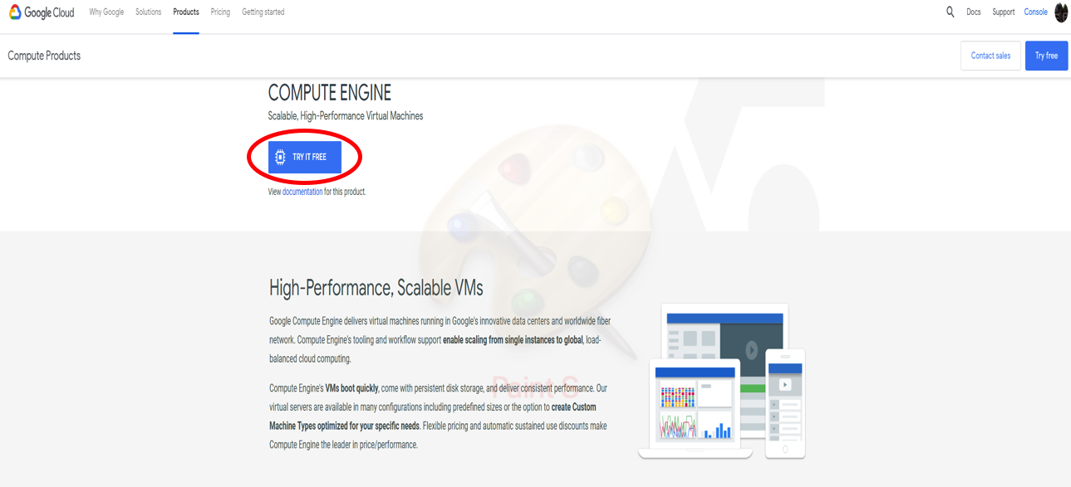
Create an account in google cloud (gc) compute engine

Slide 7
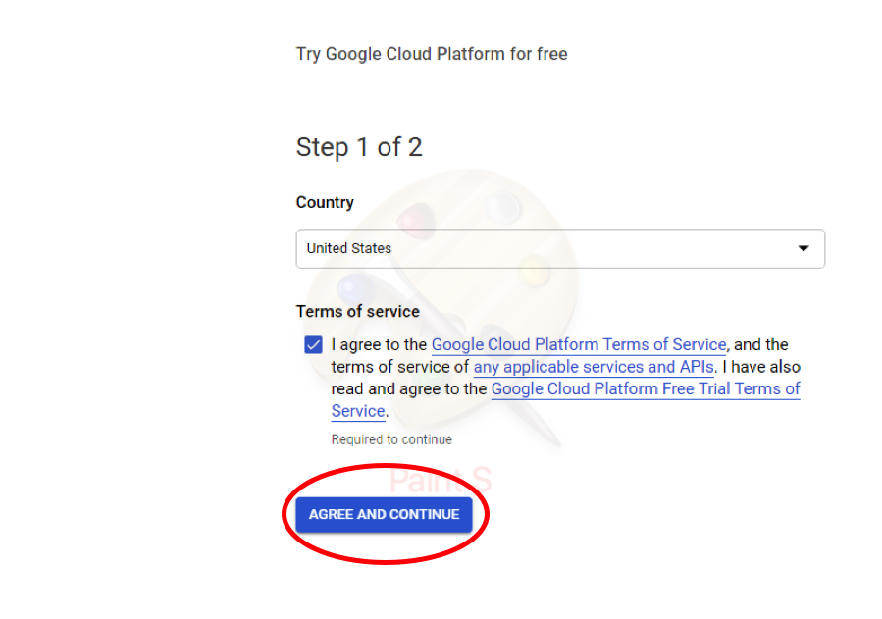
Create an account in google compute engine
Click agree and continue

Slide 8
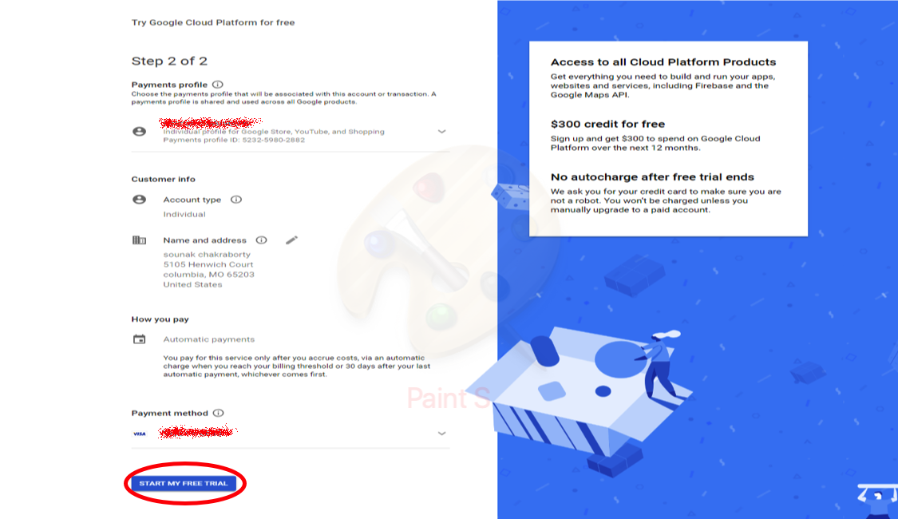
Create an account in google compute engine
Click on start my free trial
Use account type as individual; insert your name and address; insert your payment information although you get free $300 credit for 90 days

Slide 9
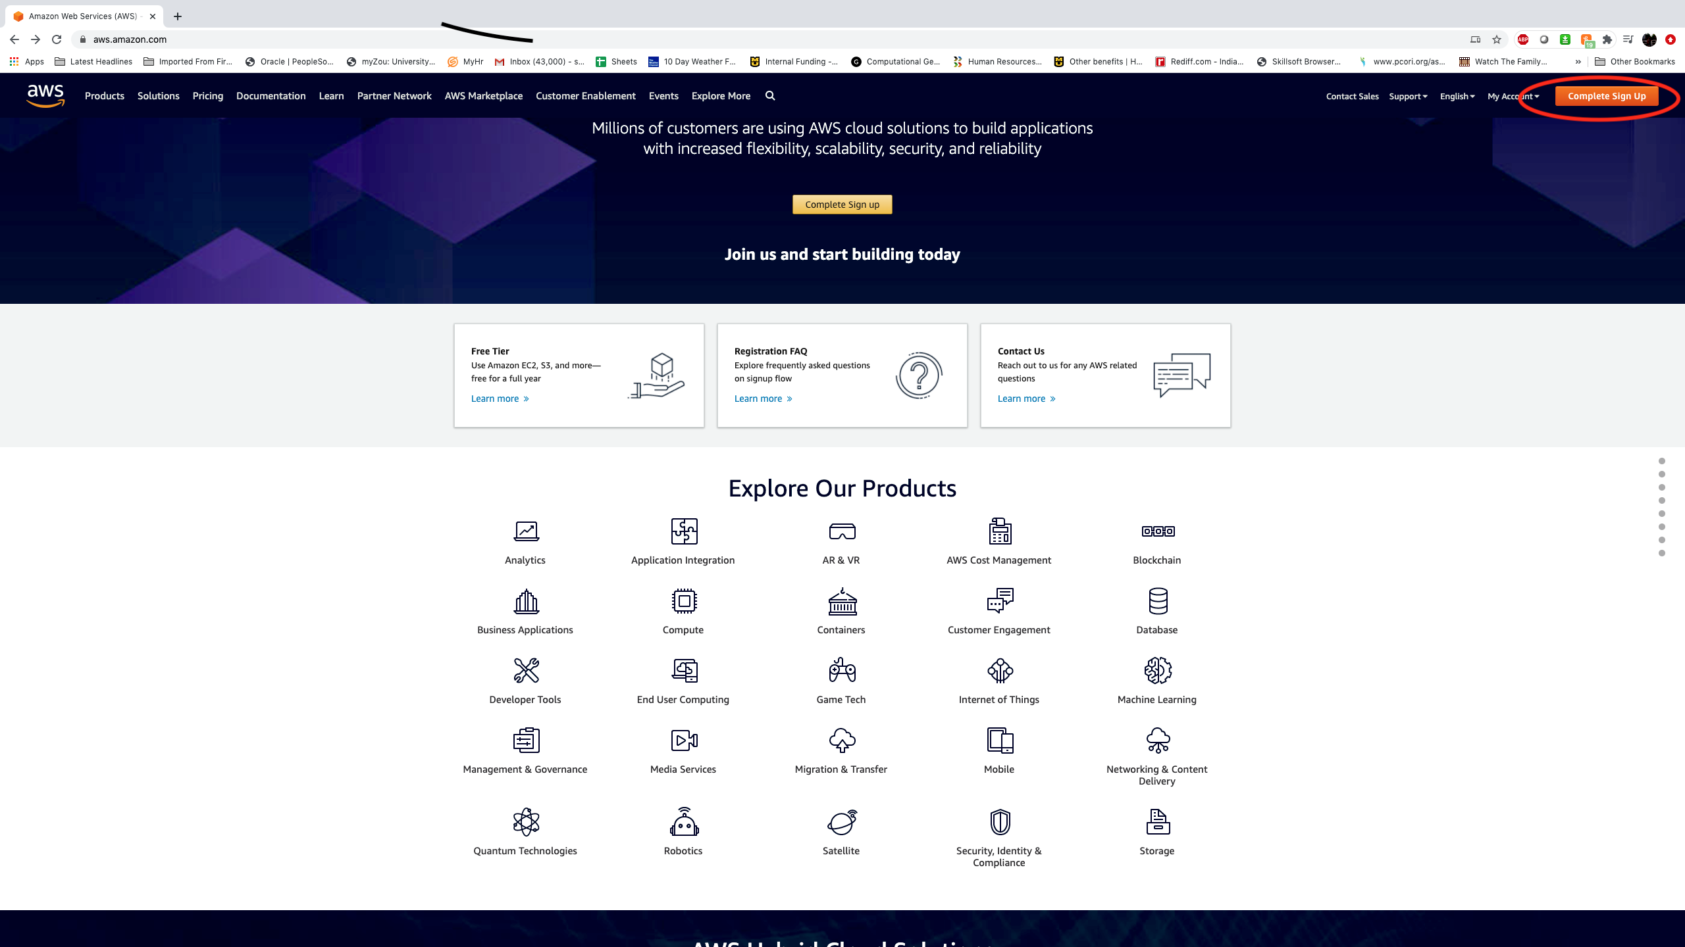
Create an account in amazon web service (aws) compute engine
Go to https://aws.amazon.com/
Click complete sign up

Slide 10
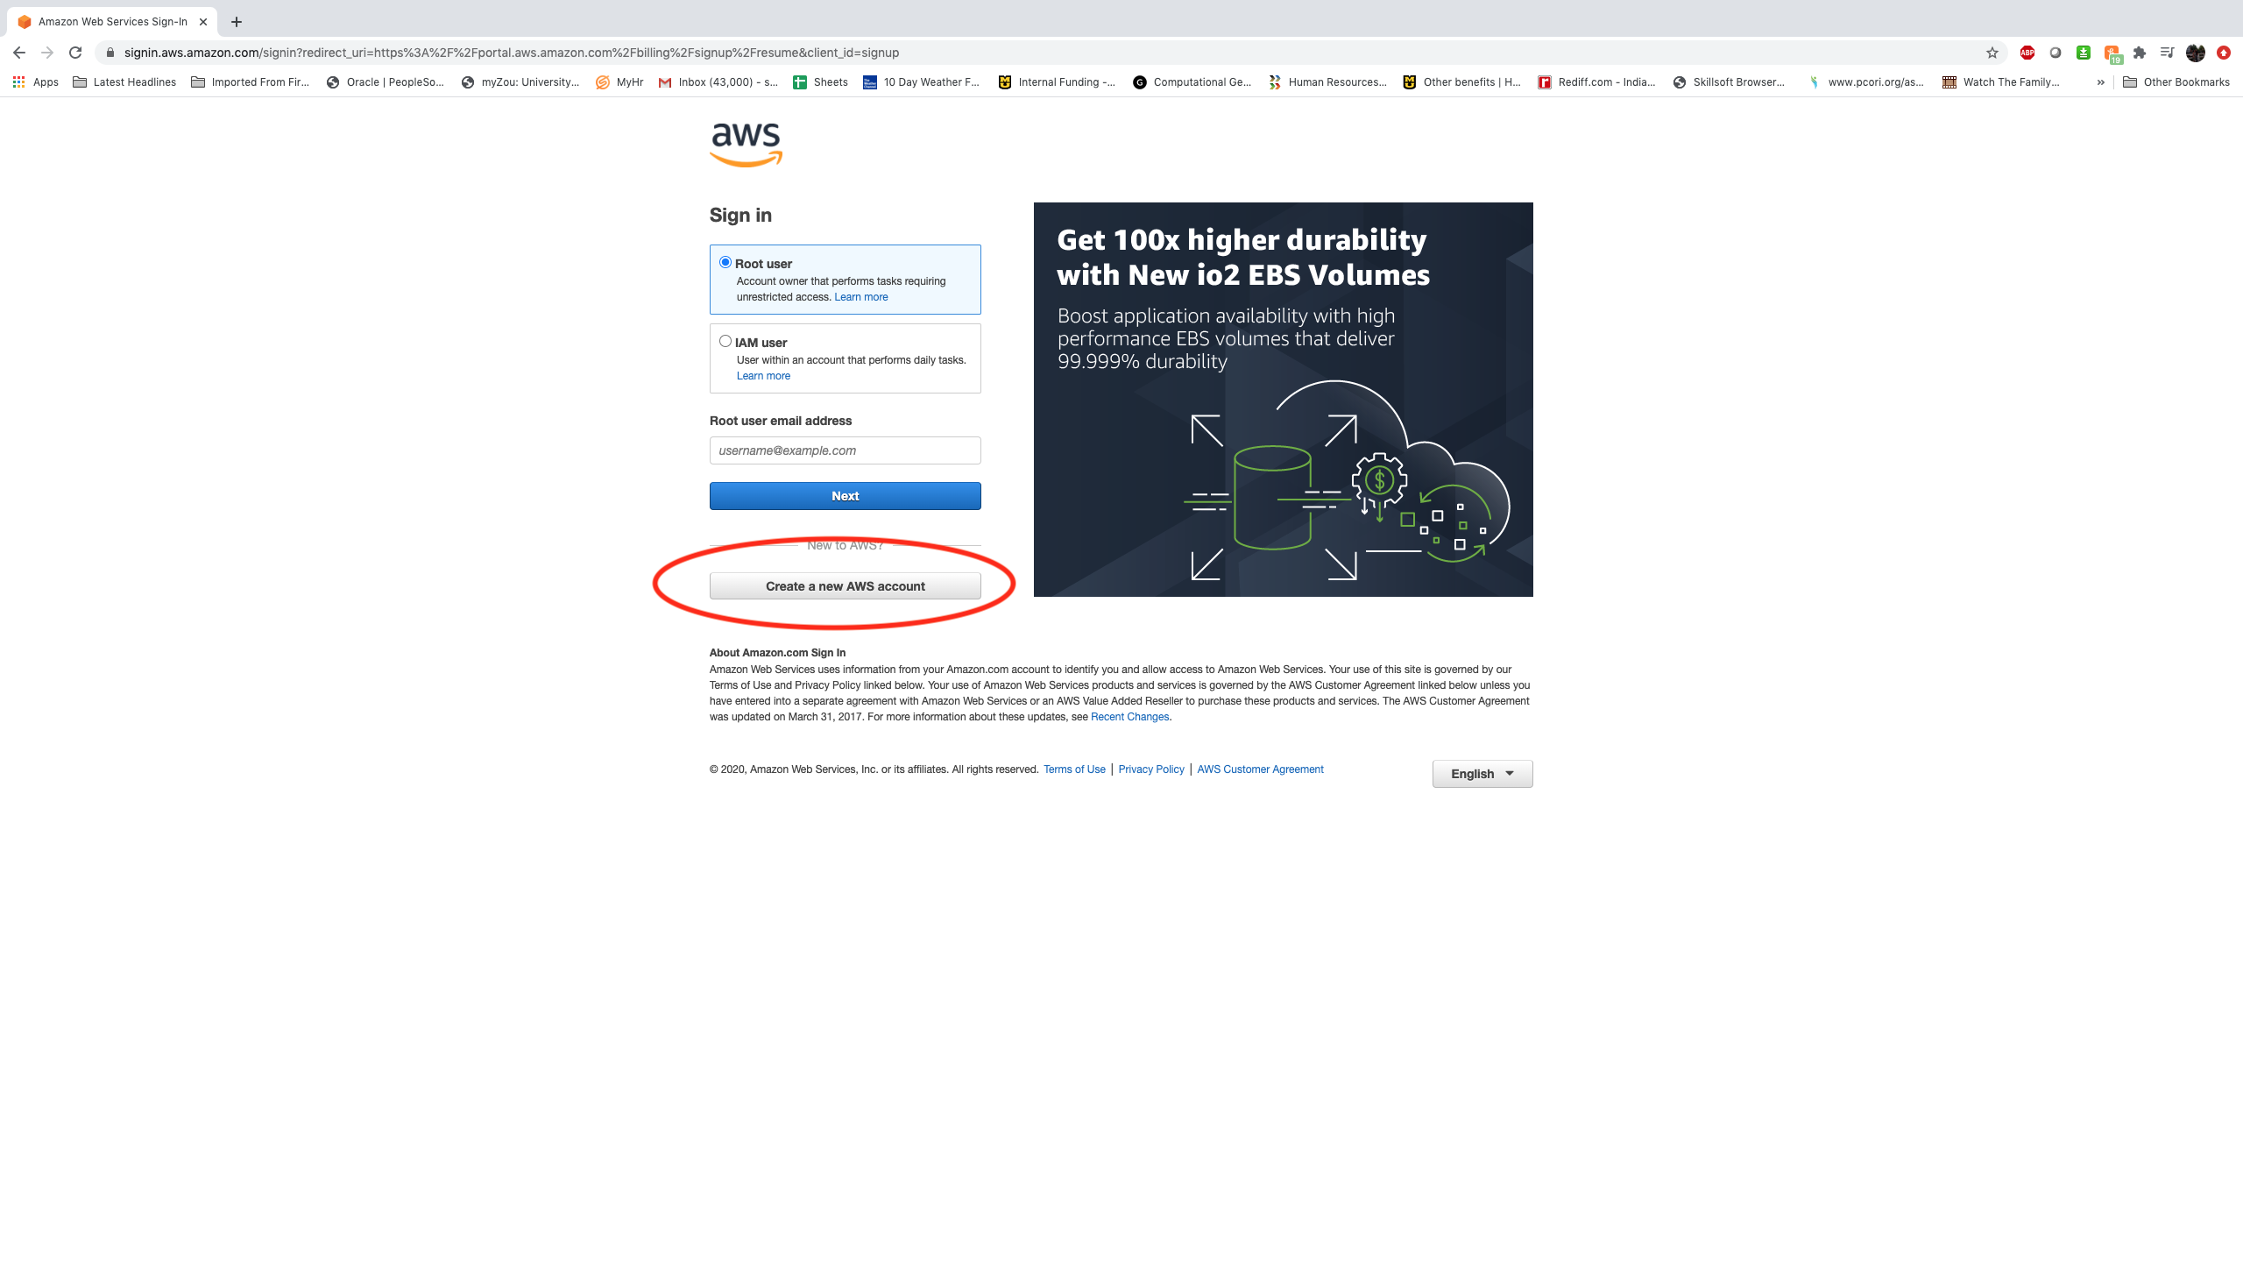
Create an account in amazon web service (aws) compute engine
Click Create a new AWS account

Slide 11
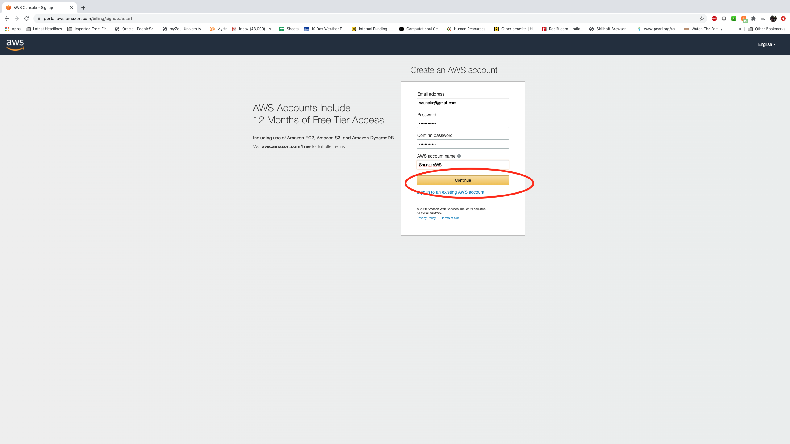
Create an account in amazon web service (aws) compute engine
Click Continue

Slide 12
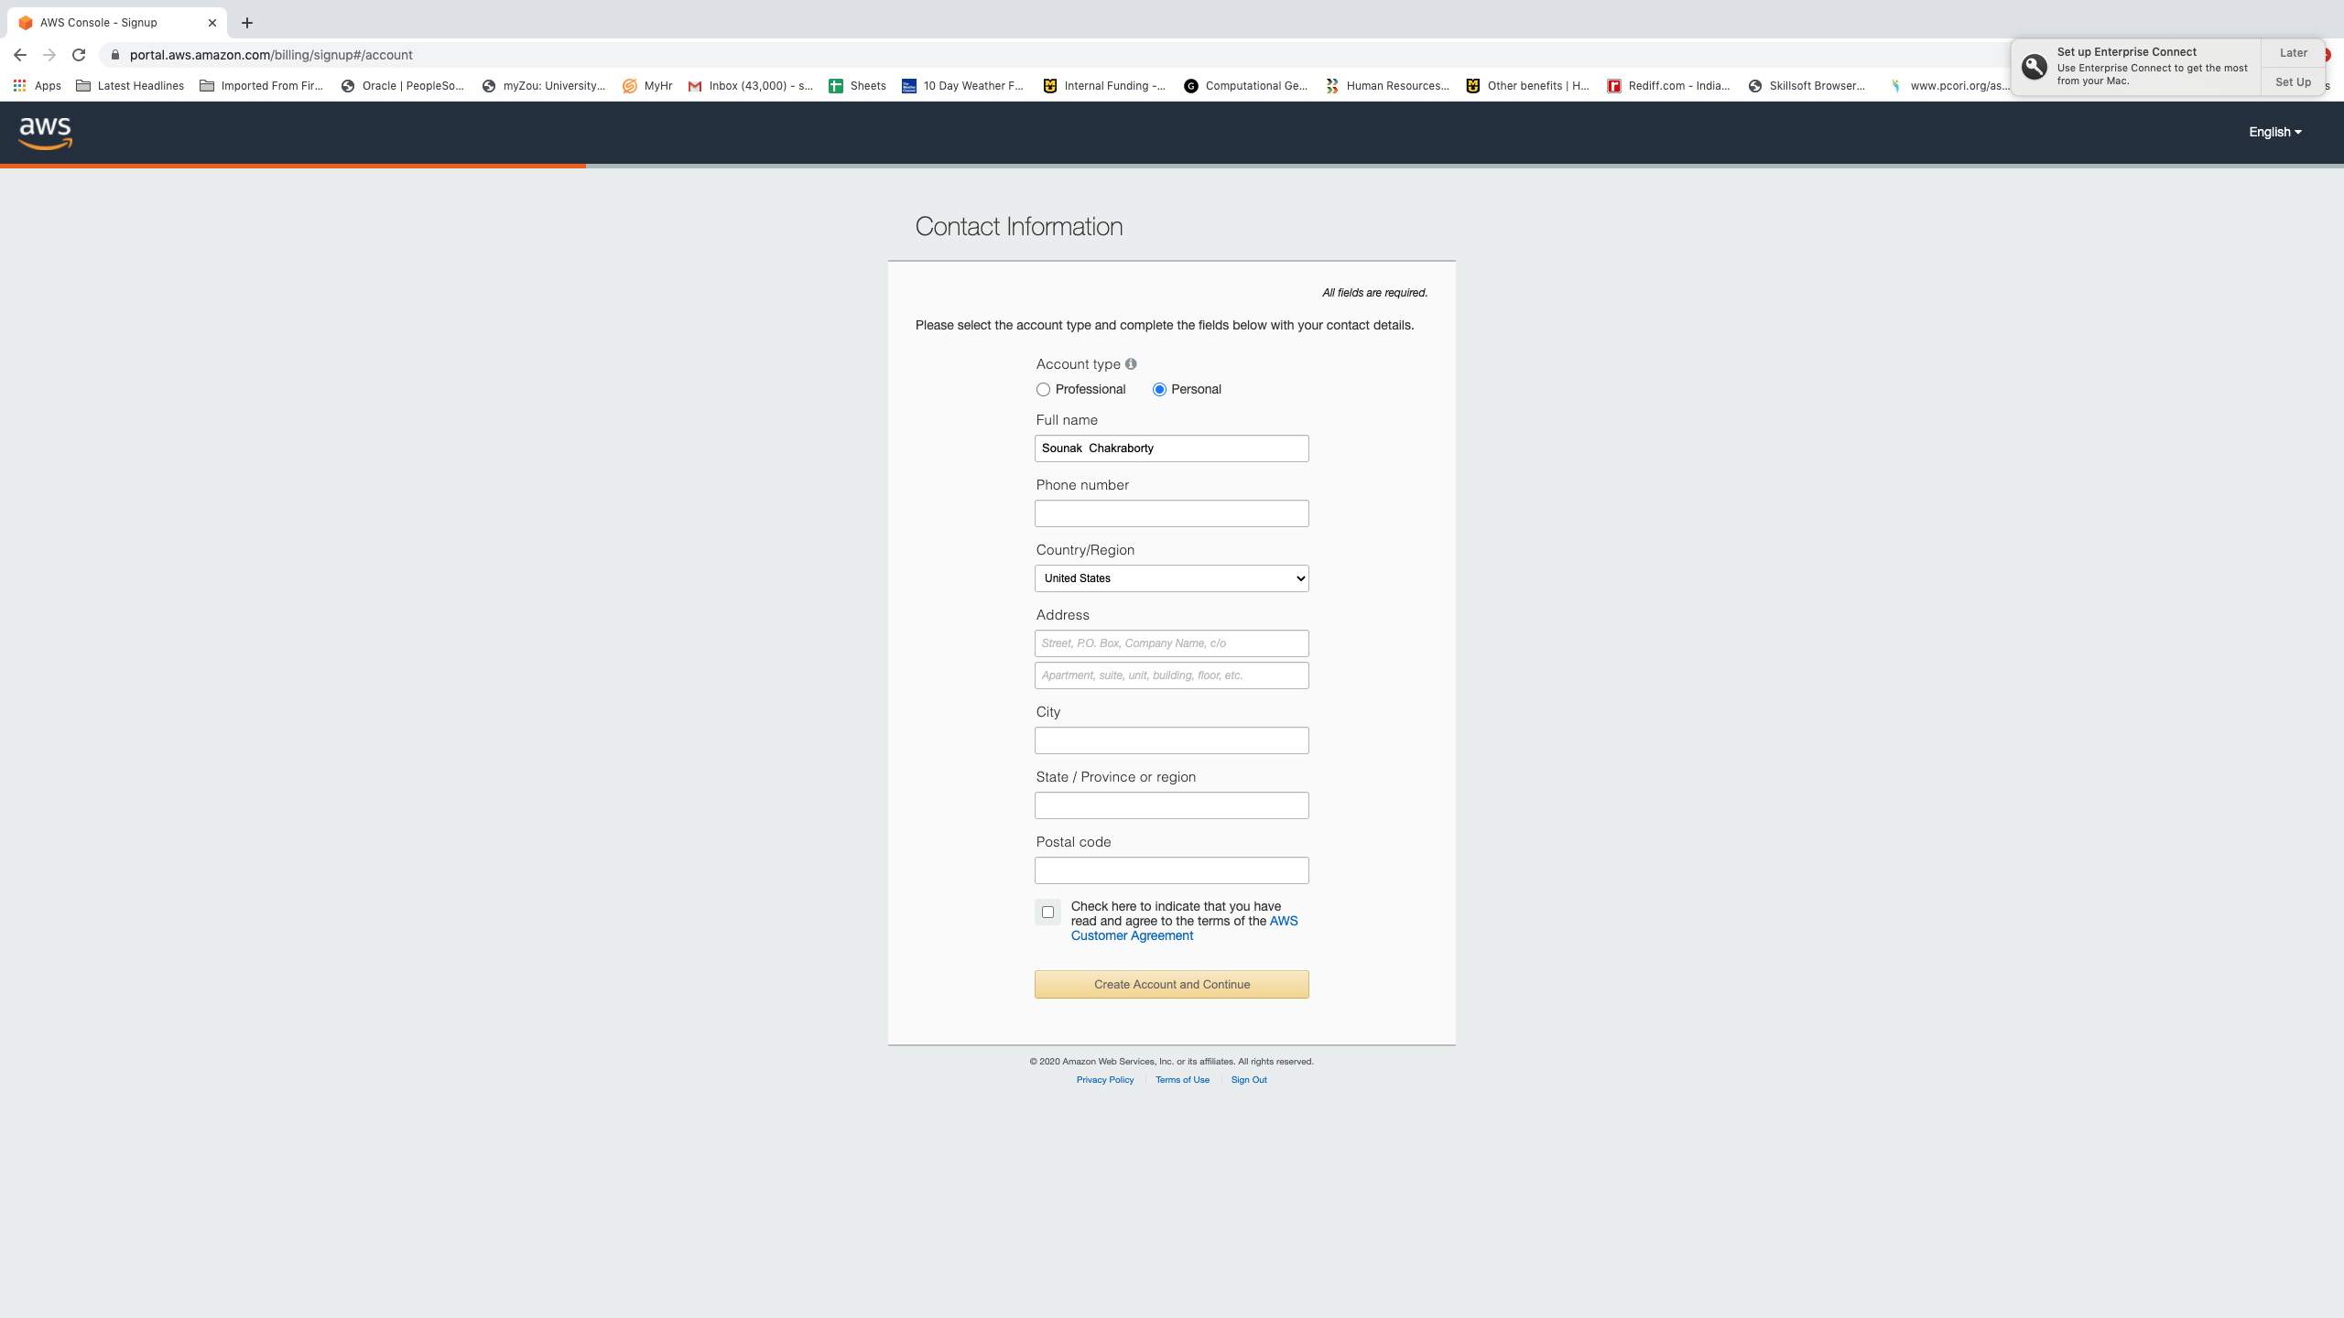
Create an account in amazon web service (aws) compute engine
Fill in the contact information. Choose account type personal

Slide 13
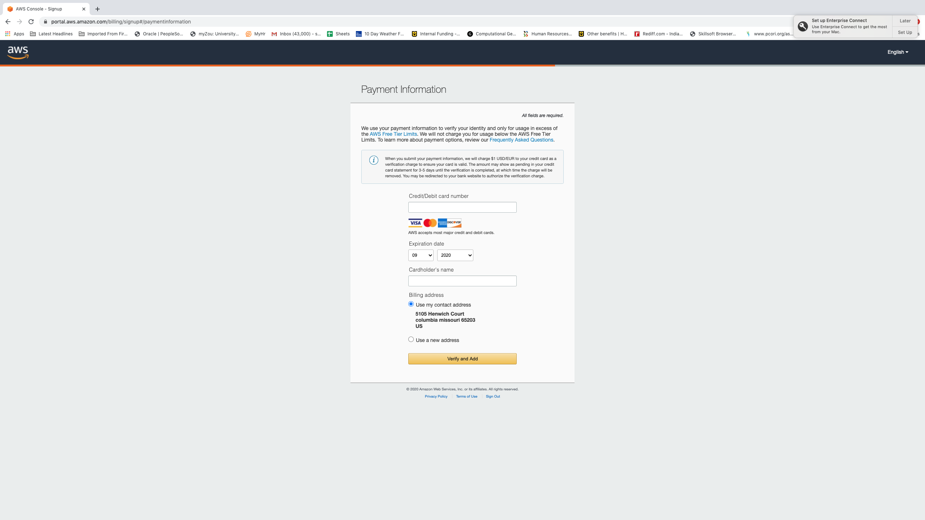
Create an account in amazon web service (aws) compute engine
Give credit card/bank information for verification process. The account you will create will be free trial account for 12 months

Slide 14
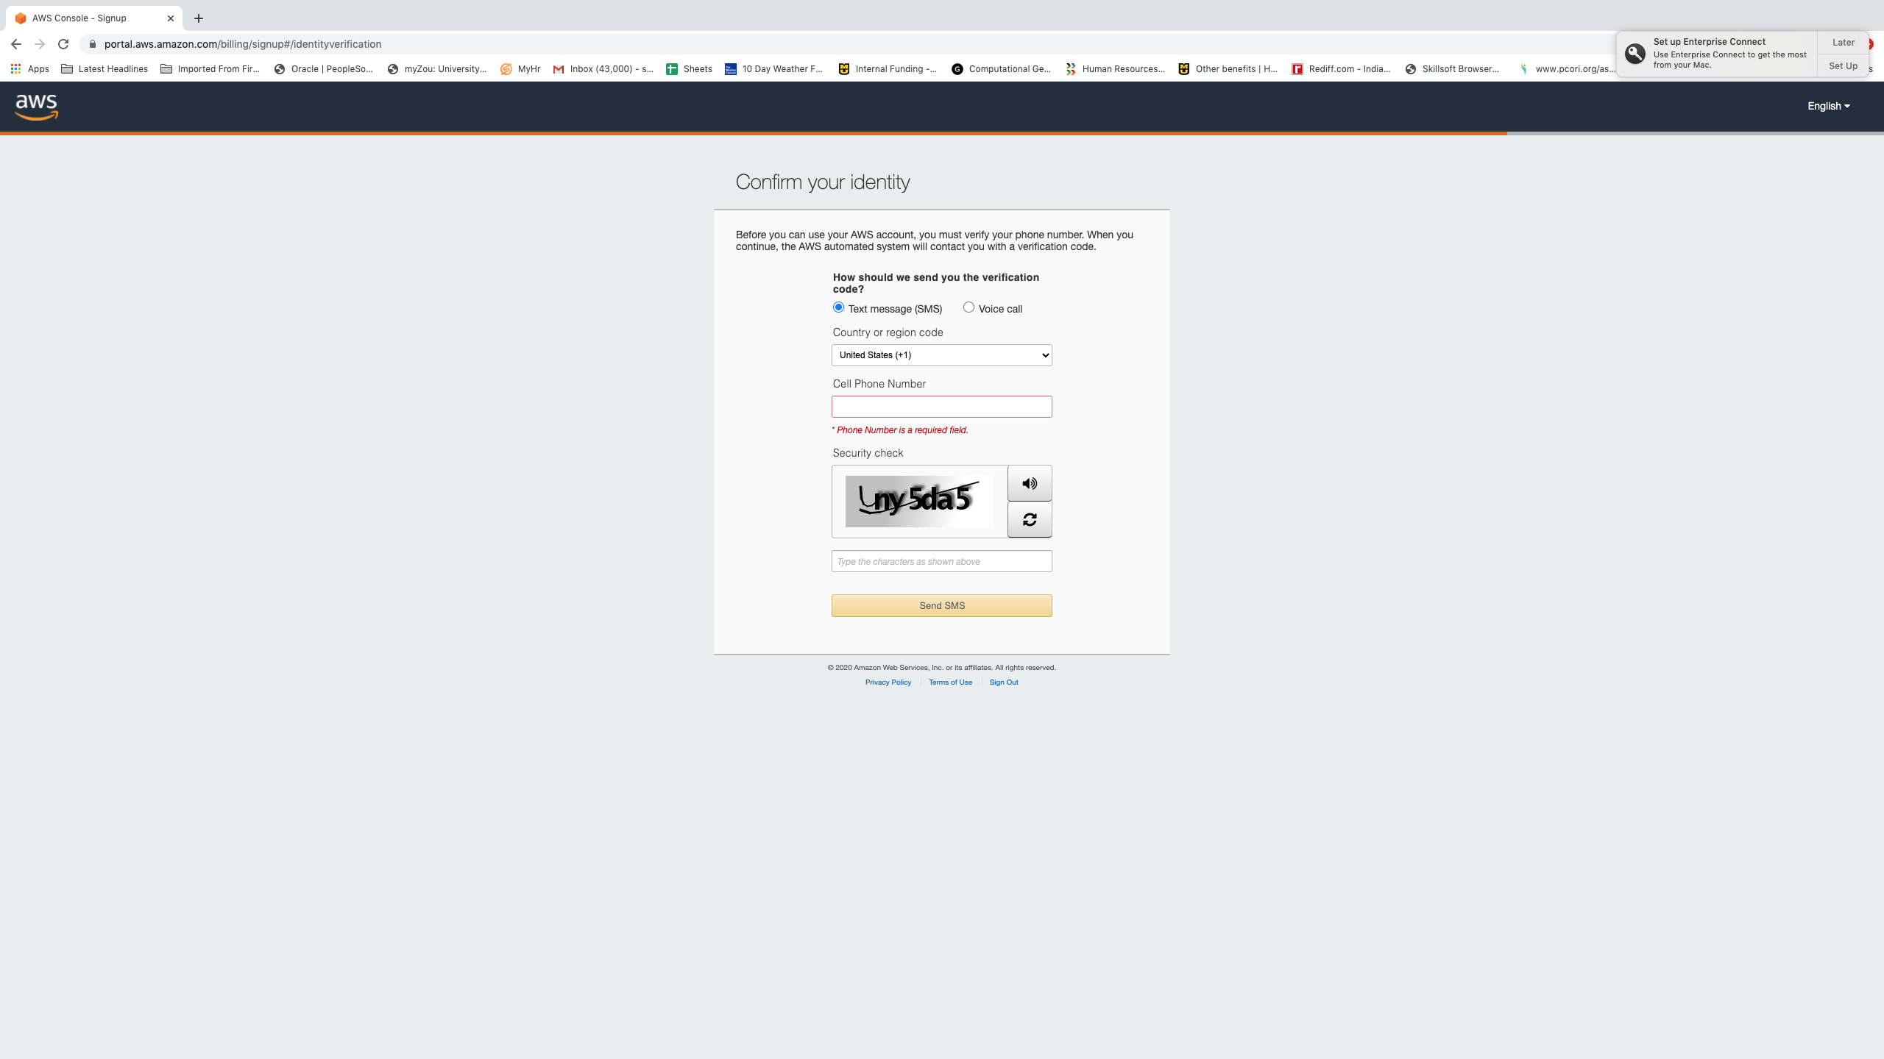
Create an account in amazon web service (aws) compute engine
Confirm your identity

Slide 15
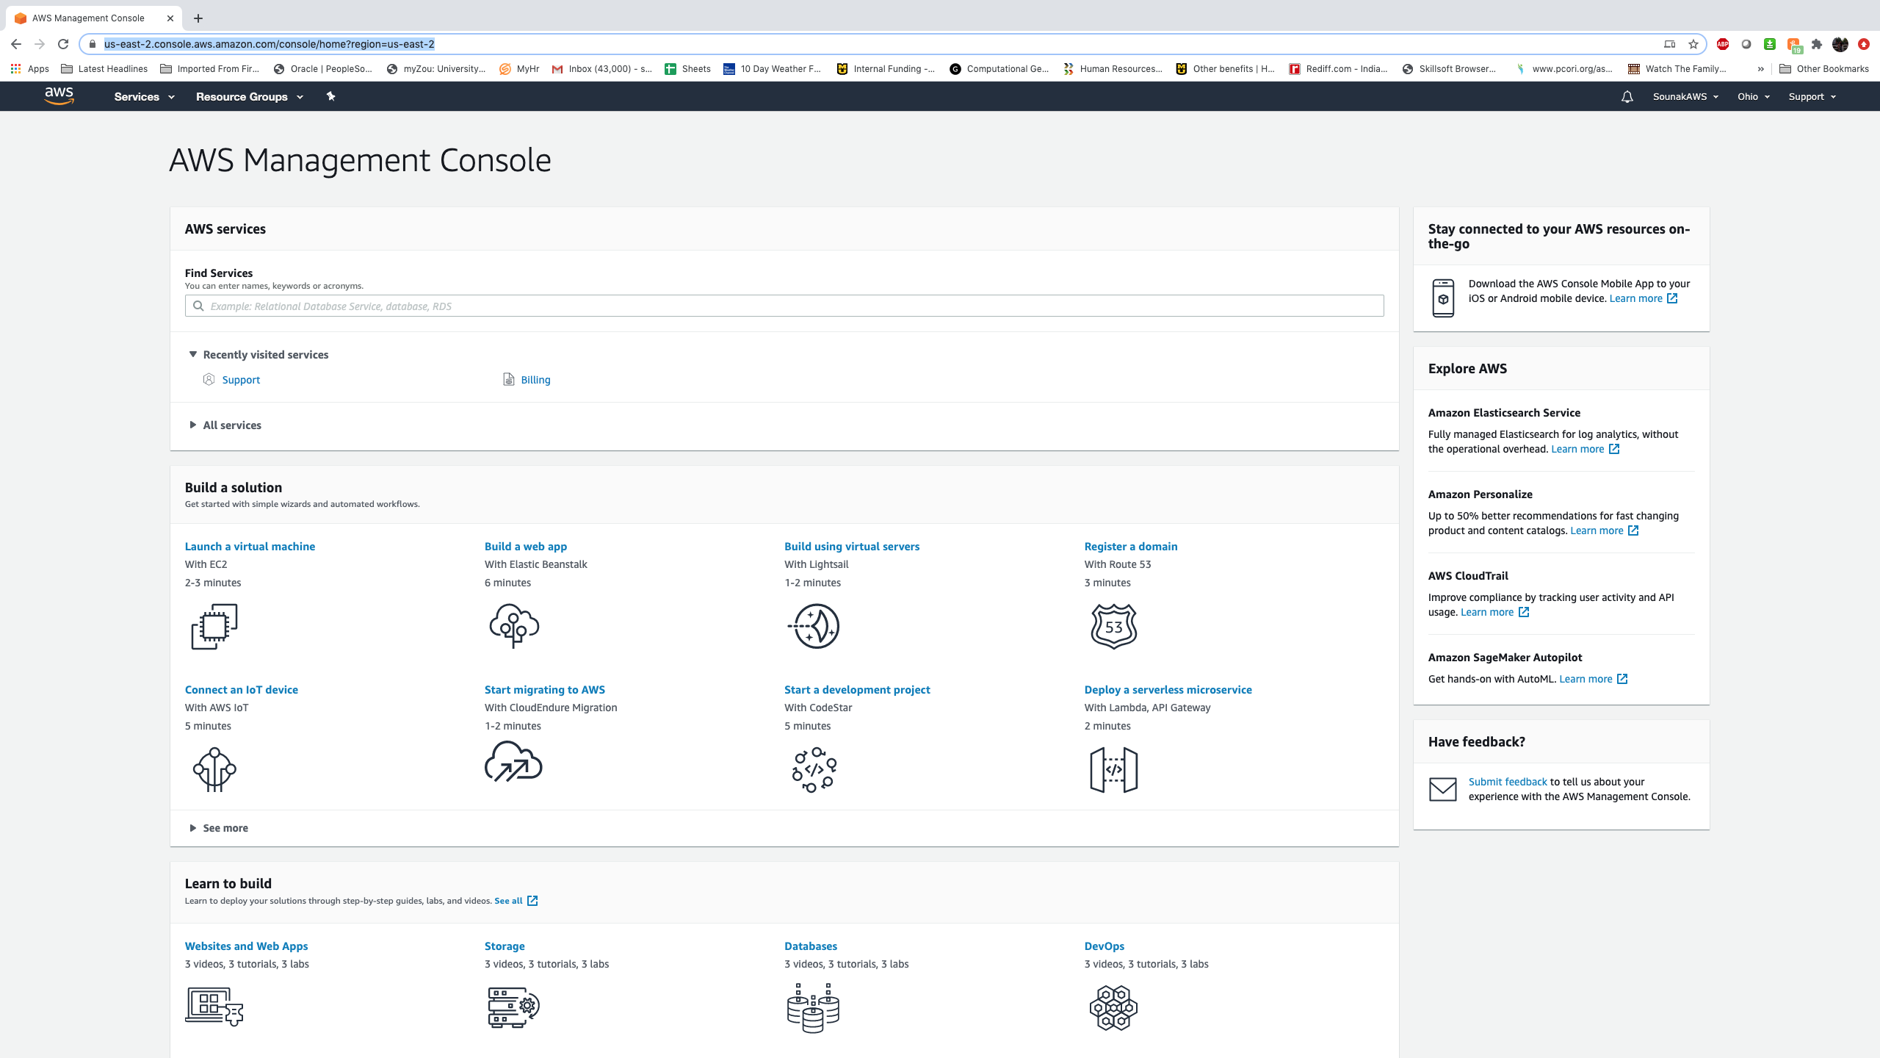
Create an account in amazon web service (aws) compute engine
In the subsequent steps choose as basic/free support plan and finish the signup process
Go to https://aws.amazon.com/ and login to your newly created aws account by clicking sign into the console. Below is the aws console homepage of your account.

Slide 16
summary
Now you have r, rstudio, google cloud, and amazon web services account needed to successfully participate in the short course
Your credit card/ bank information given by you to gc and aws is your responsibility to manage. We are not responsible for any incurred charges.
All required softwares and accounts need to be installed and created before the start of the short course

Slide 17
THANK YOU SOUNAK CHAKRABORTY CHAKRABORTYS@MISSOURI.EDU http://faculty.missouri.edu/chakrabortys/

